Slide 1
Reactive Chat
Responsive Chat over a distributed systems
Gabriele Martino

Slide 2




Introduction
Reactive chat wants to present how to integrate different tools to create a distributed systems ables to offer soft-real time features.
Frontend
Web Server
Distributed DB

Slide 3
Use cases for test
Signup (without password)
Login
Select a chat (all people are publicly accessible)
Type messages on the chat selected
Logout
All the use cases are made to test the distributed infrastructure below, not to develop an entire webapp in all its functionalities.

Slide 4
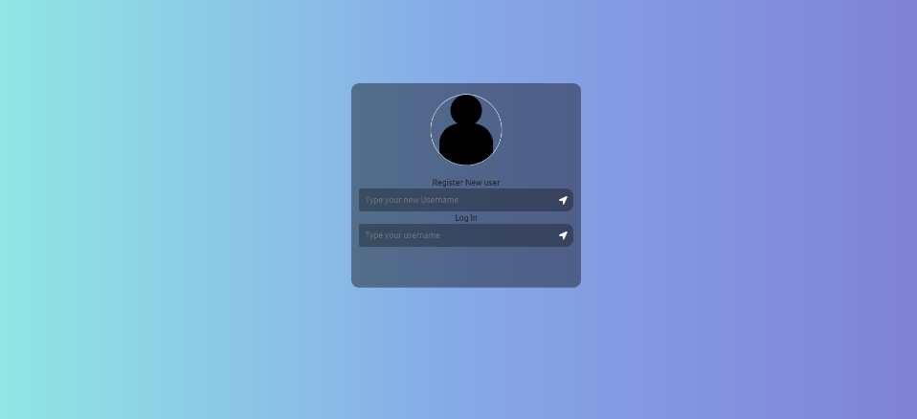
The Interface - Login

Slide 5
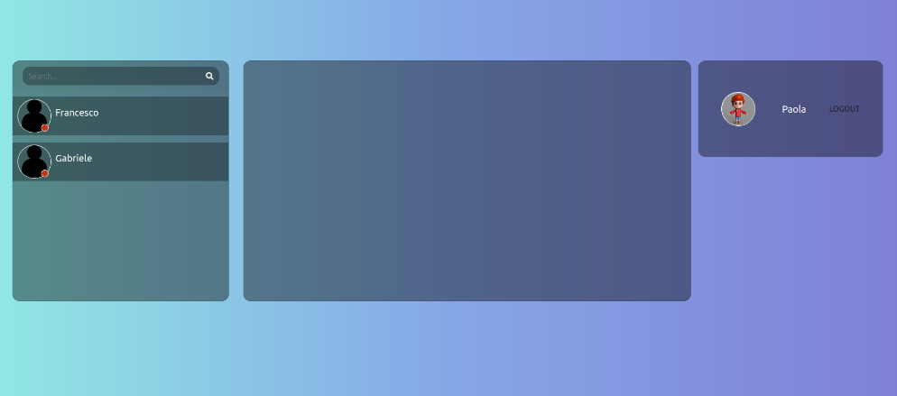
The Interface - Main Page

Slide 6
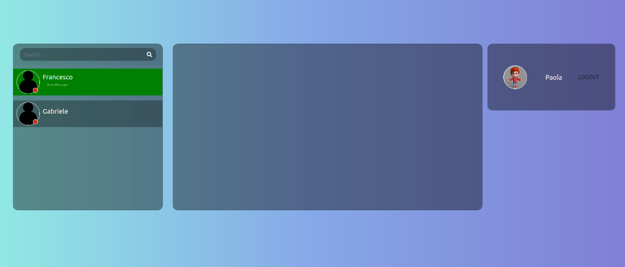
The Interface - Message Notification Arrived

Slide 7
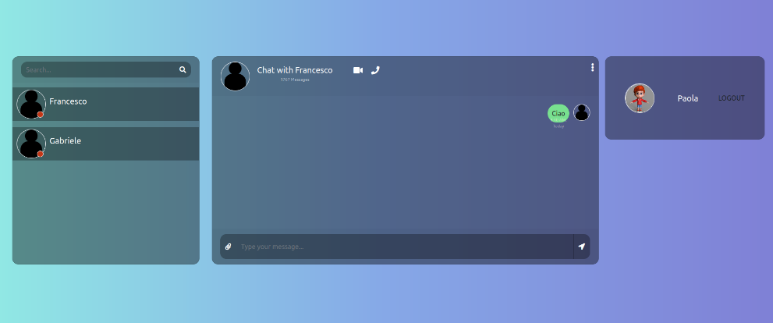
The Interface - Chat Selected

Slide 8
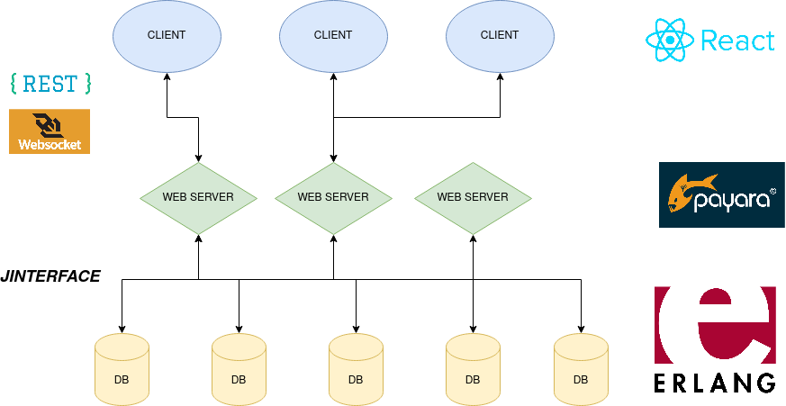
The Architecture
Multiple clients can connect to several and independent web servers.
These are connected to the distributed database.

Slide 9
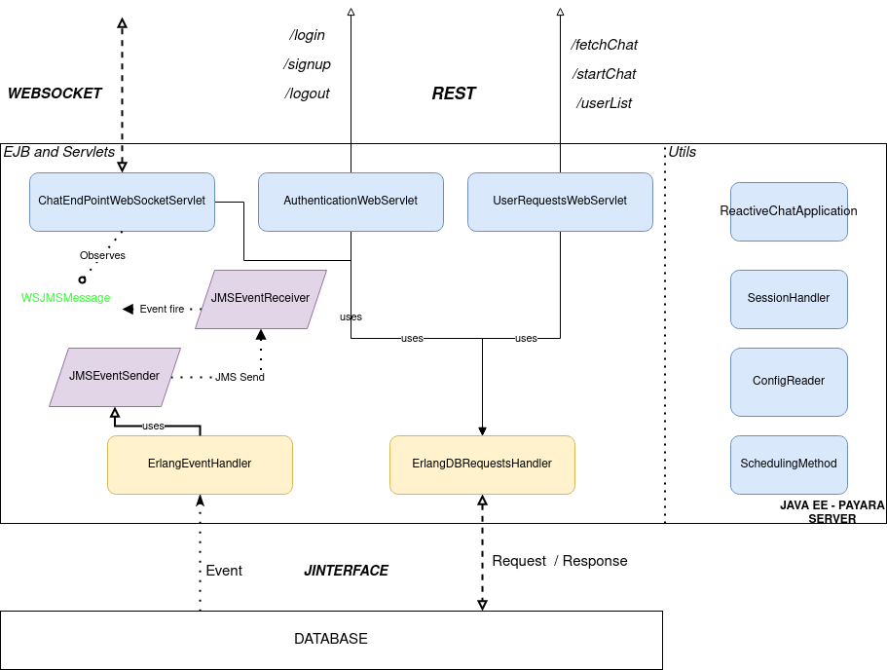
WEB SERVER - DETAILS
RESTful servlet for simple requests from the client.
WebSocket servlet for realtime chat message and new event exchange
EJBs for the communication with the DB
Message driven beans two handle asynchronous event from the DB

Slide 10

WEB SERVER - WHAT HAPPENS WHEN?
SIMPLE REST REQUEST TO SERVER
REST Request (to AuthenticationWebServlet or UserRequestWebServlet)
(1)

Slide 11
WEB SERVER - WHAT HAPPENS WHEN?
SIMPLE REQUEST TO SERVER
REST Request (to AuthenticationWebServlet or UserRequestWebServlet)
Use of the EJB to forward the request to DB
(1)
(2)

Slide 12
WEB SERVER - WHAT HAPPENS WHEN?
SIMPLE REQUEST TO SERVER
REST Request (to AuthenticationWebServlet or UserRequestWebServlet)
Use of the EJB to forward the request to DB
Report the response
(1)
(3)
(2)

Slide 13
WEB SERVER - WHAT HAPPENS WHEN?
SEND MESSAGE TO A CHAT
The message is sent over an already open websocket
(1)

Slide 14
WEB SERVER - WHAT HAPPENS WHEN?
SEND MESSAGE TO A CHAT
The message is sent over an already open websocket
The websocket servlet uses the EJB for the access to the DB
(1)
(2)

Slide 15

WEB SERVER - WHAT HAPPENS WHEN?
SEND MESSAGE TO A CHAT
The message is sent over an already opened websocket
The websocket servlet uses the EJB for the access to the DB
An event arrives from the DB of the sending message request. This event is captured from an always waiting on purpose thread.
(1)
(2)
(3)

Slide 16
WEB SERVER - WHAT HAPPENS WHEN?
SEND MESSAGE TO A CHAT
The message is sent over an already opened websocket
The websocket servlet uses the EJB for the access to the DB
An event arrives from the DB of the sending message request
This event is fired to all the web servers connected to the DB as well.
In this way if the other peer of the chat is connected to another web server it will be notified as well.
(3)

Slide 17
WEB SERVER - WHAT HAPPENS WHEN?
SEND MESSAGE TO A CHAT
The message is sent over an already opened websocket
The websocket servlet uses the EJB for the access to the DB
An event arrives from the DB of the sending message request
The event is forward over JMS
(1)
(2)
(4)
(3)

Slide 18
WEB SERVER - WHAT HAPPENS WHEN?
SEND MESSAGE TO A CHAT
The message is sent over an already opened websocket
The websocket servlet uses the EJB for the access to the DB
An event arrives from the DB of the sending message request
The event is forward over JMS
The event arrives to a JMS Receiver that fires it as Java EE internal Event.
(1)
(2)
(5)
(4)
(3)

Slide 19
WEB SERVER - WHAT HAPPENS WHEN?
SEND MESSAGE TO A CHAT
The message is sent over an already opened websocket
The websocket servlet uses the EJB for the access to the DB
An event arrives from the DB of the sending message request
The event is forward over JMS
The event arrives to a JMS Receiver that fires it as Java EE internal Event.
This event is observed from a method of the websocket servlet that check if the other peer of the chat is connected to it. In that case forward the message.
(1)
(2)
(5)
(4)
(3)

Slide 20
WEB SERVER - WHAT HAPPENS WHEN?
SEND MESSAGE TO A CHAT
The message is sent over an already opened websocket
The websocket servlet uses the EJB for the access to the DB
An event arrives from the DB of the sending message request
The event is forward over JMS
The event arrives to a JMS Receiver that fires it as Java EE internal Event.
This event is observed from a method of the websocket servlet that check if the other peer of the chat is connected to it. In that case forward the message.
It’s not possible to send the JMS message directly to Websocket servlet class simply extend it. That’s for a constraint over JAVA EE.
Moreover in a JMS System there should be at least one Sender and one Receiver.

Slide 21
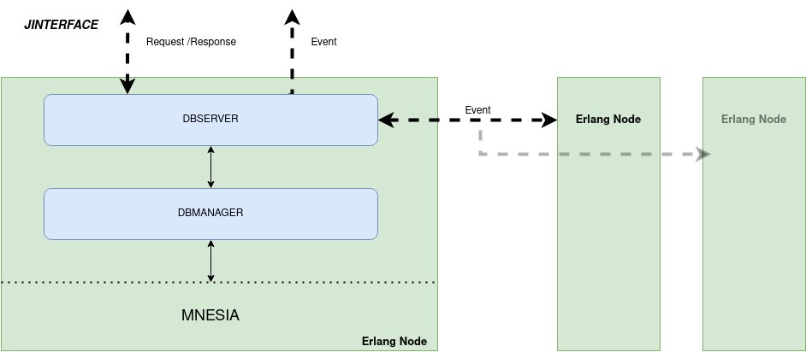
Distributed Database - Erlang - Mnesia

Slide 22
Distributed Database - Erlang - Mnesia
DBSERVER module manages the async message with the web server’s requests, dispatched events, handles communication with others erlang nodes.
DBMANAGER module provides apis for the DB access.

Slide 23
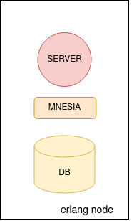
Architecture - DB Initialization
Create Master node: initialize DB

Slide 24
Architecture - DB Initialization
Create Master node: initialize DB
Add slave nodes (as many as you want)
Slave nodes only needs the name of the master node.
After the initialization all the nodes are interconnected each other.
MNESIA

Slide 25
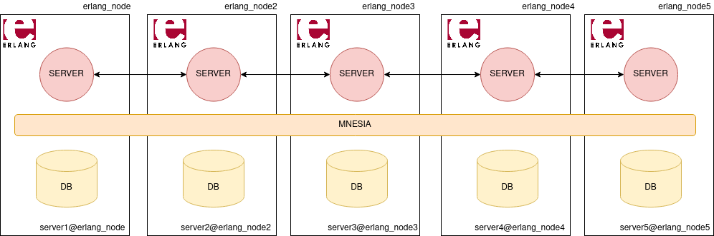
Architecture - Web Server Initialization
WEB SERVER
The web server uses Jinterface to connect to all the erlang nodes

Slide 26
Architecture - Web Server Initialization
WEB SERVER
The web server uses Jinterface to connect to all the erlang nodes
The web server registers an event handler to a randomly selected erlang node

Slide 27
Let’s put all together - Nodes Communication (i)
WEB SERVER
WEB SERVER

Slide 28
Let’s put all together - Nodes Communication (ii)
Sending a message
Use Round Robin to select a DB server node that will cover the request
WEB SERVER
WEB SERVER
(1)

Slide 29
Let’s put all together - Nodes Communication (ii)
Sending a message
Use Round Robin to select a DB server node that will cover the request
Broadcast the writing message event to all the erlang nodes
WEB SERVER
WEB SERVER
(1)
(2)

Slide 30
Let’s put all together - Nodes Communication (ii)
Sending a message
Use Round Robin to select a DB server node that will cover the request
Broadcast the writing message event to all the erlang nodes
The erlang nodes that have web server’s event handler registered will send this event respectively
WEB SERVER
WEB SERVER
(3)
(1)
(2)

Slide 31
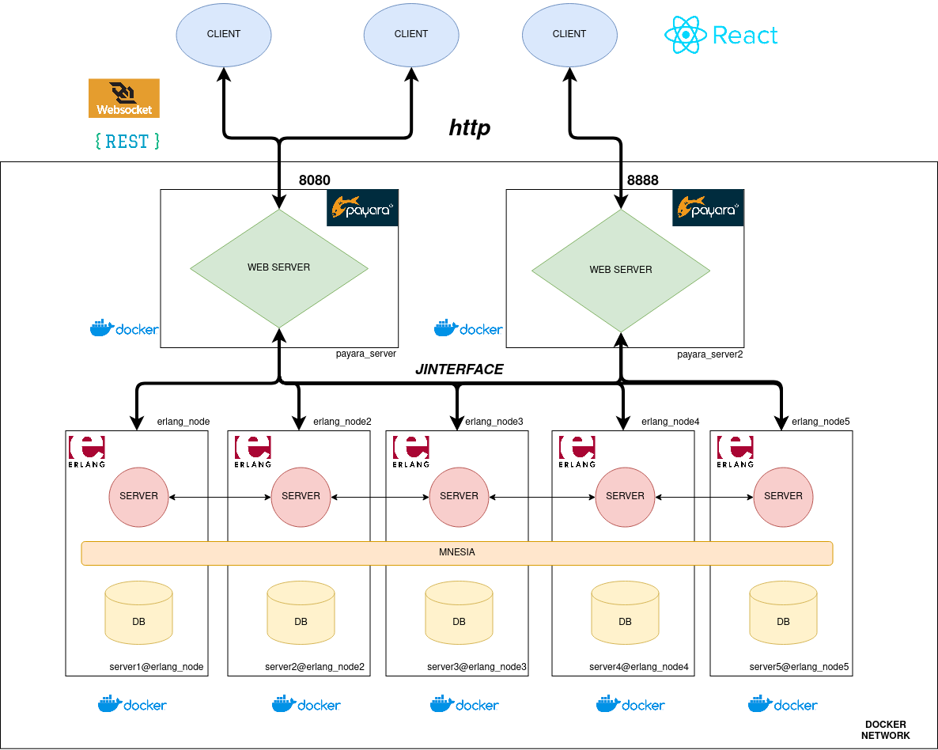
Deployment Test
All the nodes are on a separate docker container.
All the container are connected over a virtual network inside the docker environment.
We used hostnames rather than IPs relying on the DNS inside the docker network.

